Slide 1
Teacher Forcing and Exposure Bias
bran

Slide 2
contents
What is Teacher Forcing
Exposure Bias
Solutions
Conclusion

Slide 3
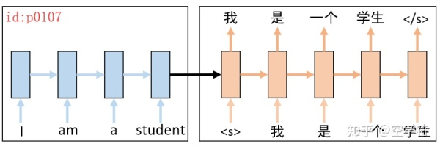
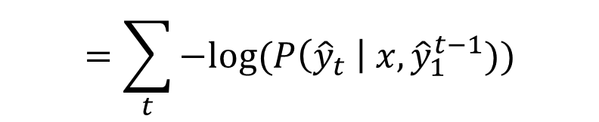
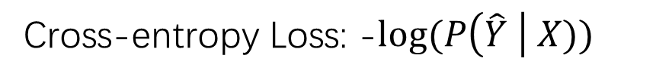
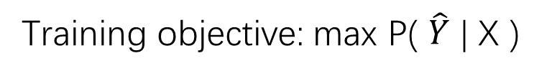
What is Teacher Forcing
Training objective: max P( $\hat{Y}$ | X )
Cross-entropy Loss: -$log⁡(P\left(\hat{Y} \right| X))$
$$=−\log\left(P\left({\hat{y}}_{1} \right| x\right)P\left({\hat{y}}_{2} \right| x, {\hat{y}}_{1})…P\left({\hat{y}}_{t} \right| x, {\hat{y}}_{1}^{t−1}))$$
$$=\sum_{t}{−log⁡(P\left({\hat{y}}_{t} \right| x, {\hat{y}}_{1}^{t−1})})$$
Notes:
Task seq2seq model as example
It is impossible for the model to give the probability of y hat directly. Bayes theorem

Slide 4
Testing
Free running
Should we use teacher forcing on validation set ?
It’s optional

Slide 5
Problems of Teacher Forcing
There are lots of problems of teacher forcing, such as exposure bias and loss-evaluation mismatch.
Exposure bias: the model is never exposed to its own errors during training, and so the inferred histories at test-time do not resemble the gold training histories.
Loss-evaluation Mismatch: the training loss is word level while the test metric is sentence level
Notes:
Beam search

Slide 6
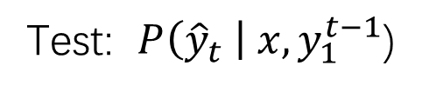
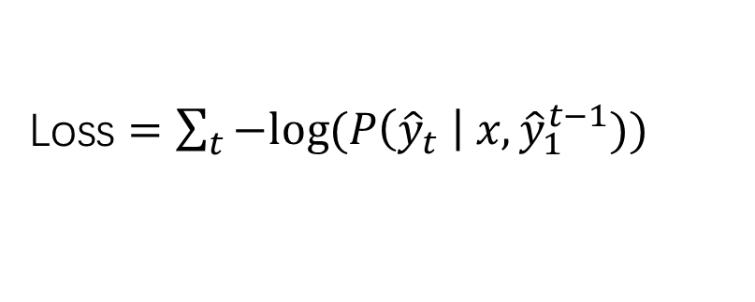
Loss $=\sum_{t}{−log⁡(P\left({\hat{y}}_{t} \right| x, {\hat{y}}_{1}^{t−1})})$
Test: $P\left({\hat{y}}_{t} \right| x, y_{1}^{t−1}$)
Notes:
For these two parts, the model are predicts ground truth under different distribution. In training is the distribution of data. While in test is the distribution of the model’s prediction. At each time step in training we told the model which to predict under the ground truth.
However in test if the model makes a mistake, then it doesn’t know which to predict because it never trained with it’s own predicted distribution which means it never meets such situation in training, so it might make a mistake again
So the error will accumulate, the predicted sentence will be far away from the ground truth

Slide 7
Solutions
Beam search
Scheduled sampling
Reinforcement Learning
Professor Forcing (GAN)

Slide 8
Beam search
Compare with greedy search, beam search uses a larger search space, so it can help model to correct some mistakes.
0.9
c
0.36
(Ground Truth)
a
0.4
d
0.1
0.04
start
0.55
c
0.33
0.6
b
d
0.26
0.45

Slide 9
Beam search
Compare with greedy search, beam search uses a larger search space, so it can help model to correct some mistakes.
0.1
c
0.04
a
0.4
d
0.9
0.36
start
0.55
c
0.33
(Ground Truth)
0.6
b
d
0.26
0.45

Slide 10
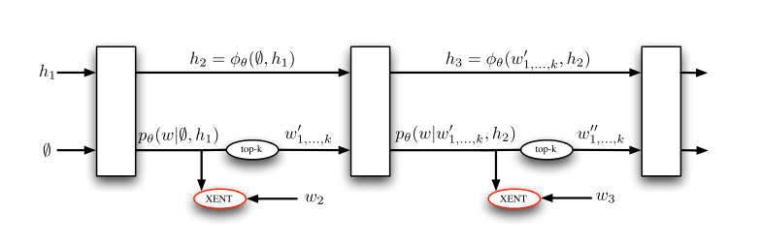
End-to-End Backprop (E2E) (Ranzato, 2015)
Use beam search at training. Choose top k output to feed into the next time step
Notes:
So in order to solve this problem, we need to train the model with it’s own prediction distribution
You need to do a lot of extra computation for beam search

Slide 11
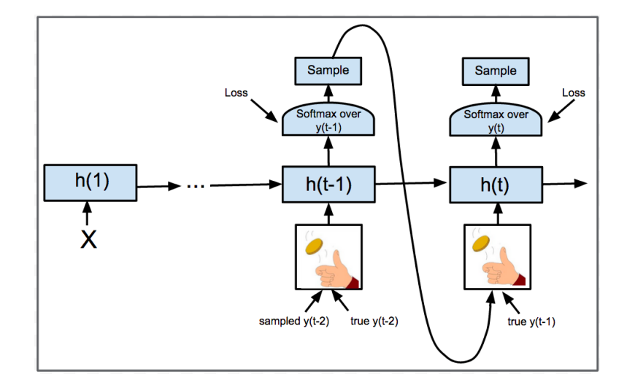
Scheduled Sampling ( Bengio, 2015)
Question: how to choose p?
Fixed P
Small p at beginning, increase p during training
Large p at beginning, decrease p during training
1-p
1-p
p
p
Bridging the Gap between Training and Inference for Neural Machine Translation, ACL, 2019
Notes:
The best paper of ACL 2019 also uses schedule sampling. They add a sentence level sampling to solve the loss-evaluation mismatch problem

Slide 12
Reinforcement Learning( Ranzato, 2015)
Use BLEU, ROUGE or other sentence-level metrics as reward. RL model can directly trained with these metrics. So it can avoid the exposure bias issue in MLE.

Slide 13
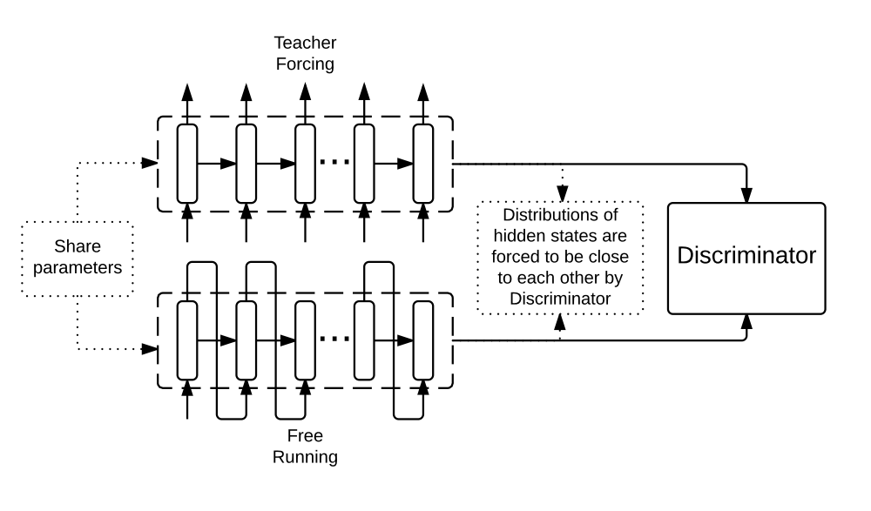
Professor Forcing (GAN) (Goyal, 2016)

Slide 14
Conclusion
In this talk I first introduced the teacher forcing, then some problems of teacher forcing
Then I introduced some current solutions of exposure bias.
If we find the model performances bad in inferring and well with teacher forcing, we should consider the exposure bias problem.

Slide 15
Thanks!

